Slide 1

Community Detection in Graphs
CS246: Mining Massive Datasets
Jure Leskovec, Stanford University
http://cs246.stanford.edu

Slide 2
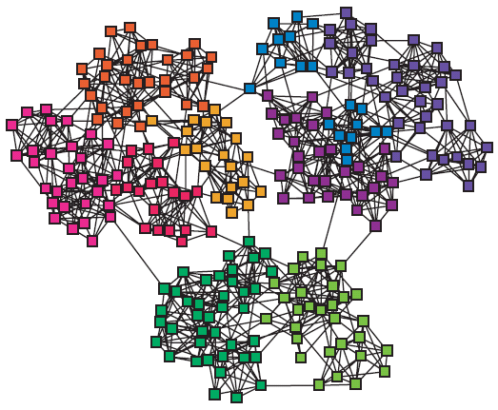
Networks & Communities
We often think of networks being organized into modules, cluster, communities:

Slide 3
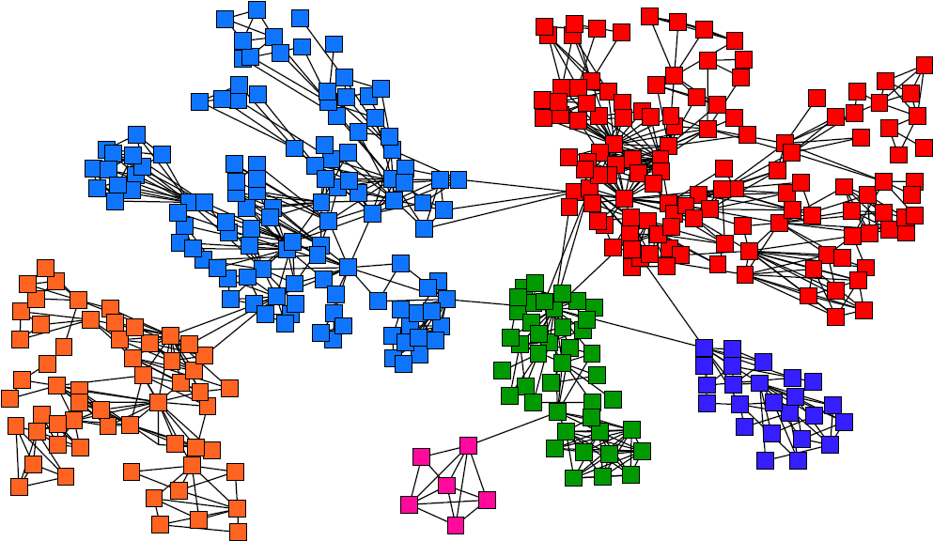
Goal: Find Densely Linked Clusters

Slide 4
Non-overlapping Clusters
Nodes
Nodes
Network
Adjacency matrix

Slide 5
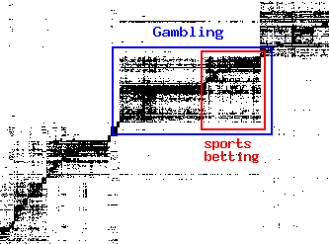
Micro-Markets in Sponsored Search
Find micro-markets by partitioning the query-to-advertiser graph:
query
advertiser
[Andersen, Lang: Communities from seed sets, 2006]

Slide 6
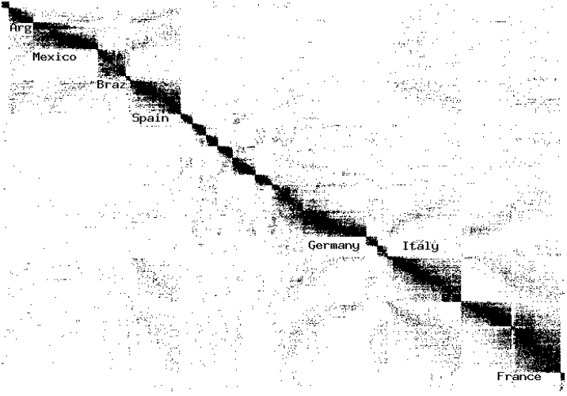
Movies and Actors
Clusters in Movies-to-Actors graph:
[Andersen, Lang: Communities from seed sets, 2006]

Slide 7
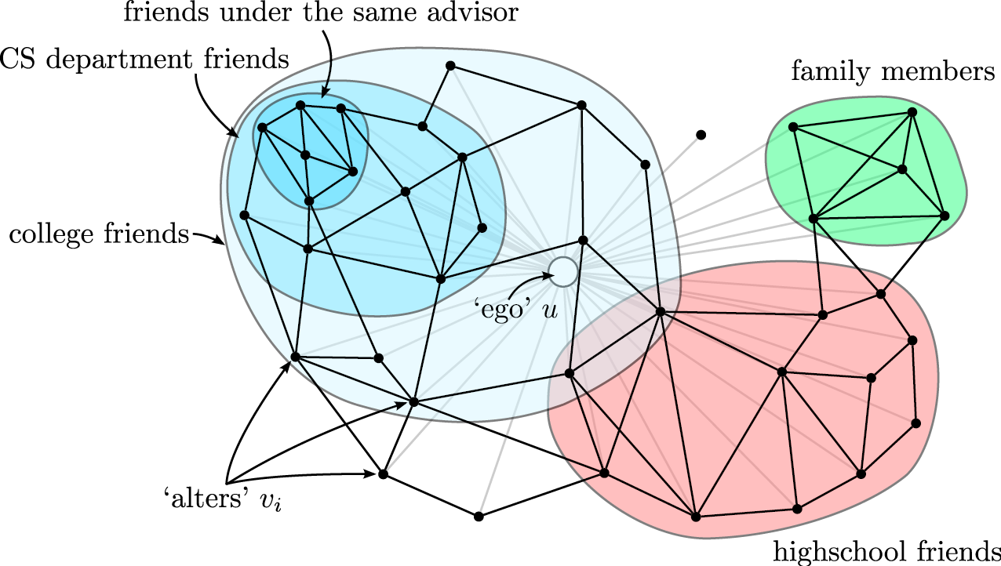
Twitter & Facebook
Discovering social circles, circles of trust:
[McAuley, Leskovec: Discovering social circles in ego networks, 2012]

Slide 8
The Setting
Graph is large
Assume the graph fits in main memory
For example, to work with a 200M node and 2B edge graph one needs approx. 16GB RAM
But the graph is too big for running anything more than linear time algorithms
We will cover a PageRank based algorithm for finding dense clusters
The runtime of the algorithm will be proportional to the cluster size (not the graph size!)

Slide 9
Idea: Seed Nodes
Discovering clusters based on seed nodes
Given: Seed node s
Compute (approximate) Personalized PageRank (PPR) around node s (teleport set={s})
Idea is that if s belongs to a nice cluster, the random walk will get trapped inside the cluster
Seed node

Slide 10
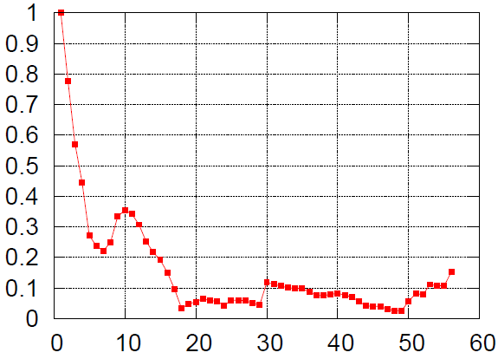
Seed Node: Intuition
Good clusters
Cluster “quality” (lower is better)
Seed node
Algorithm outline:
Pick a seed node s of interest
Run PPR with teleport set = {s}
Sort the nodes by the decreasing PPR score
Sweep over the nodes and find good clusters
Node rank in decreasing PPR score

Slide 11
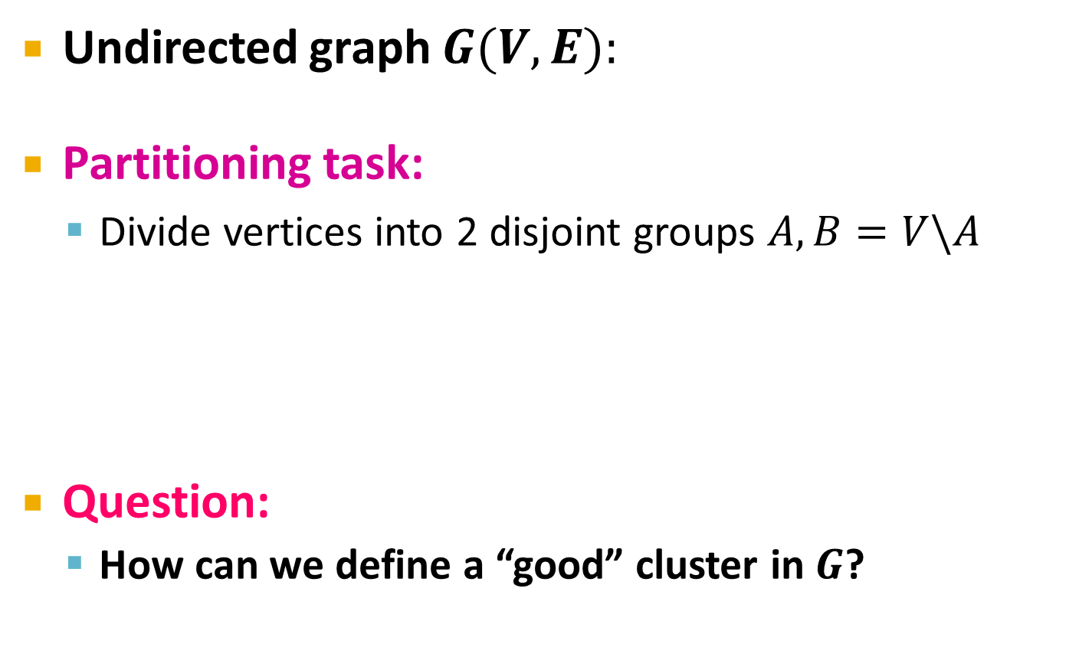
What makes a good cluster?
1
5
Undirected graph $G(V,E):$
Partitioning task:
Divide vertices into 2 disjoint groups $A, B=V\backslash A$
Question:
How can we define a “good” cluster in $G$?
2
6
4
3
A
5
B=V\A
1
2
6
3
4

Slide 12
What makes a good cluster?
What makes a good cluster?
Maximize the number of within-cluster connections
Minimize the number of between-cluster connections
5
1
2
6
4
3
A
V\A

Slide 13
Graph Cuts
Express cluster quality as a function of the “edge cut” of the cluster
Cut: Set of edges with only one node in the cluster:
Note: This works for weighed and unweighted (set all w_{ij}=1) graphs
A
5
1
cut(A) = 2
2
6
4
3

Slide 14
Cut Score
Partition quality: Cut score
Quality of a cluster is the weight of connections pointing outside the cluster
Degenerate case:
Problem:
Only considers external cluster connections
Does not consider internal cluster connectivity
“Optimal cut”
Minimum cut

Slide 15
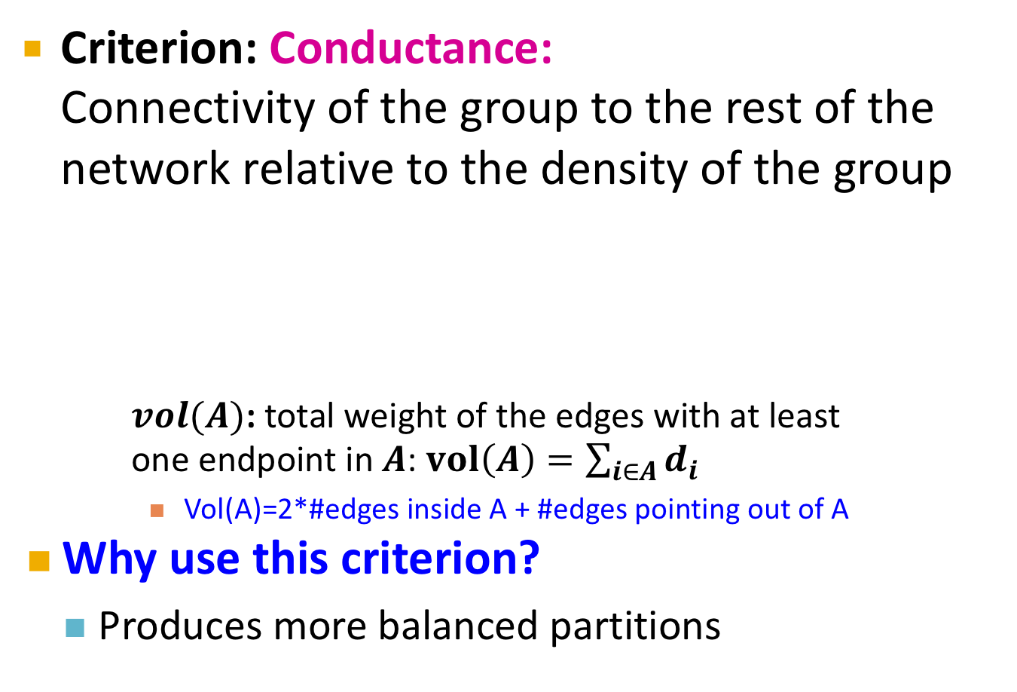
Graph Partitioning Criteria
[Shi-Malik]
Criterion: Conductance: Connectivity of the group to the rest of the network relative to the density of the group
$vol(A)$: total weight of the edges with at least one endpoint in $A$: $vol\left(A\right)=\sum_{i∈A}{d_{i}}$
Vol(A)=2*#edges inside A + #edges pointing out of A
Why use this criterion?
Produces more balanced partitions
m… number of edges of the graph
d_{i}… degree of node i

Slide 16
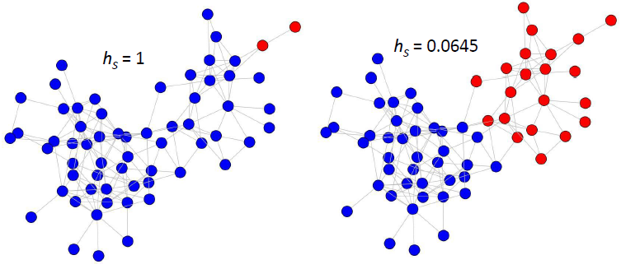
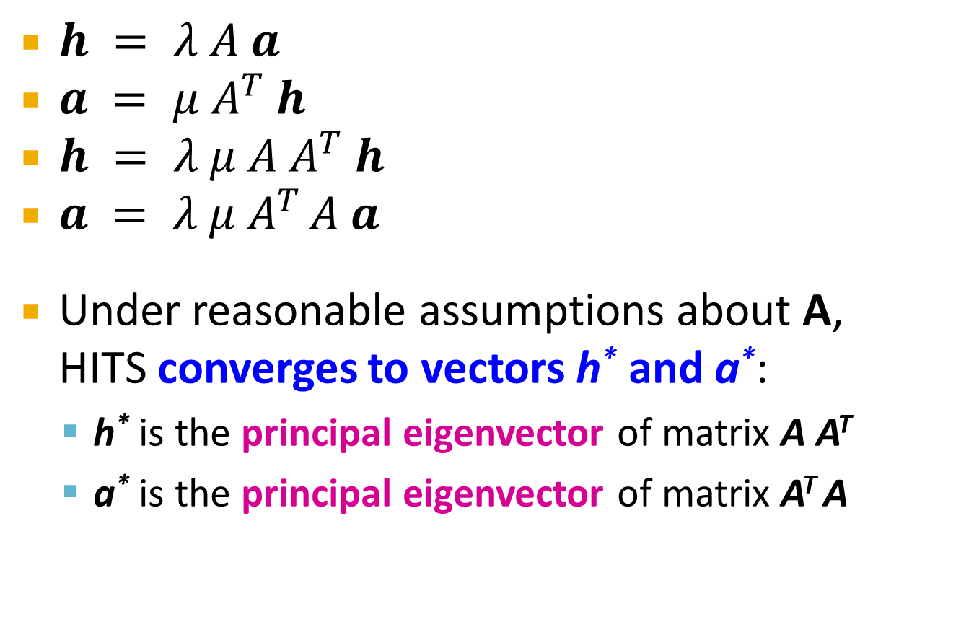
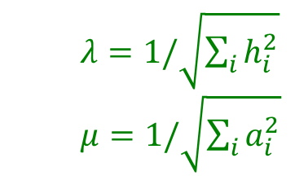
Example: Conductance Score
$$φ=2/4=0.5$$
$$φ=6/92=0.065$$

Slide 17

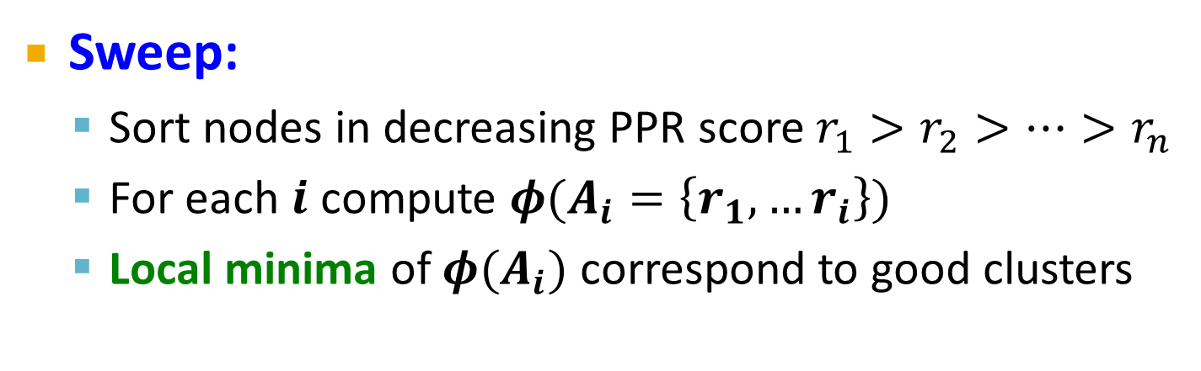
Algorithm Outline: Sweep
Algorithm outline:
Pick a seed node s of interest
Run PPR w/ teleport={s}
Sort the nodes by the decreasing PPR score
Sweep over the nodes and find good clusters
Good clusters
Conductance $φ\left(A_{i}\right)$
Node rank i in decreasing PPR score
Sweep:
Sort nodes in decreasing PPR score $r_{1}>r_{2}>…>r_{n}$
For each $i$ compute $φ(A_{i}=\left\{r_{1},…r_{i}\right\})$
Local minima of $φ(A_{i})$ correspond to good clusters

Slide 18
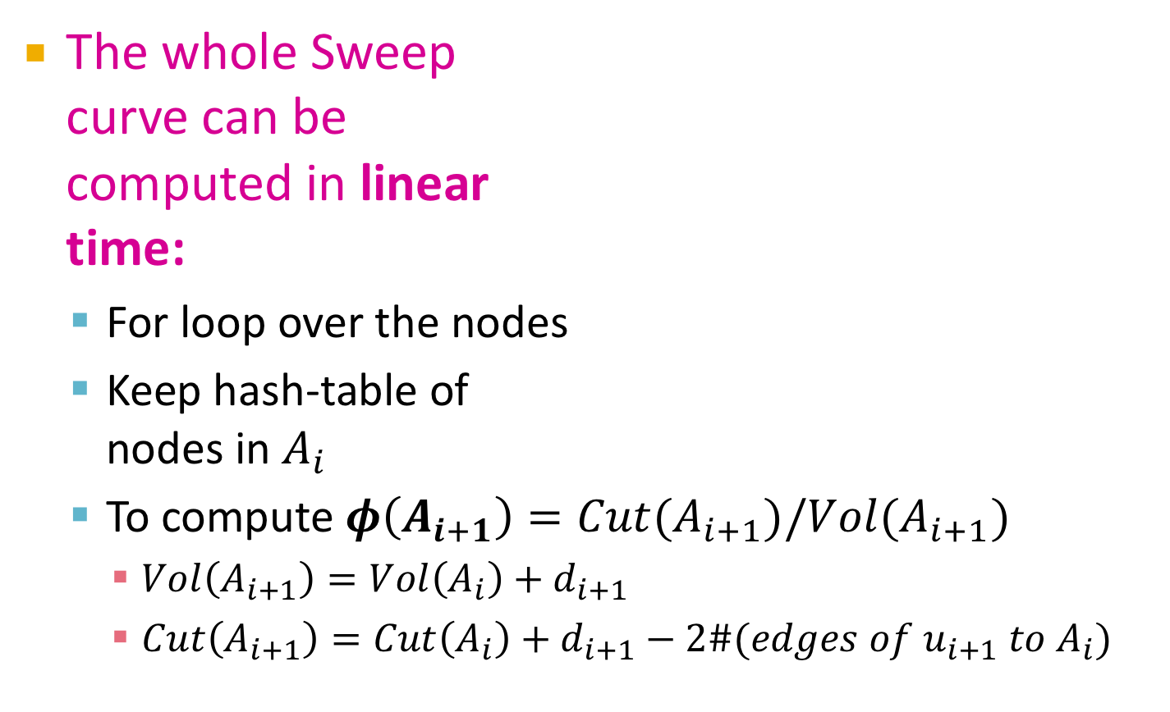
Computing the Sweep
The whole Sweep curve can be computed in linear time:
For loop over the nodes
Keep hash-table of nodes in $A_{i}$
To compute $φ\left(A_{i+1}\right)=Cut(A_{i+1})/Vol(A_{i+1})$
$Vol\left(A_{i+1}\right)=Vol\left(A_{i}\right)+d_{i+1}$
$Cut\left(A_{i+1}\right)=Cut\left(A_{i}\right)+d_{i+1}−2\#(edges of u_{i+1} to A_{i})$
Good clusters
Conductance $φ\left(A_{i}\right)$
Node rank i in decreasing PPR score

Slide 19
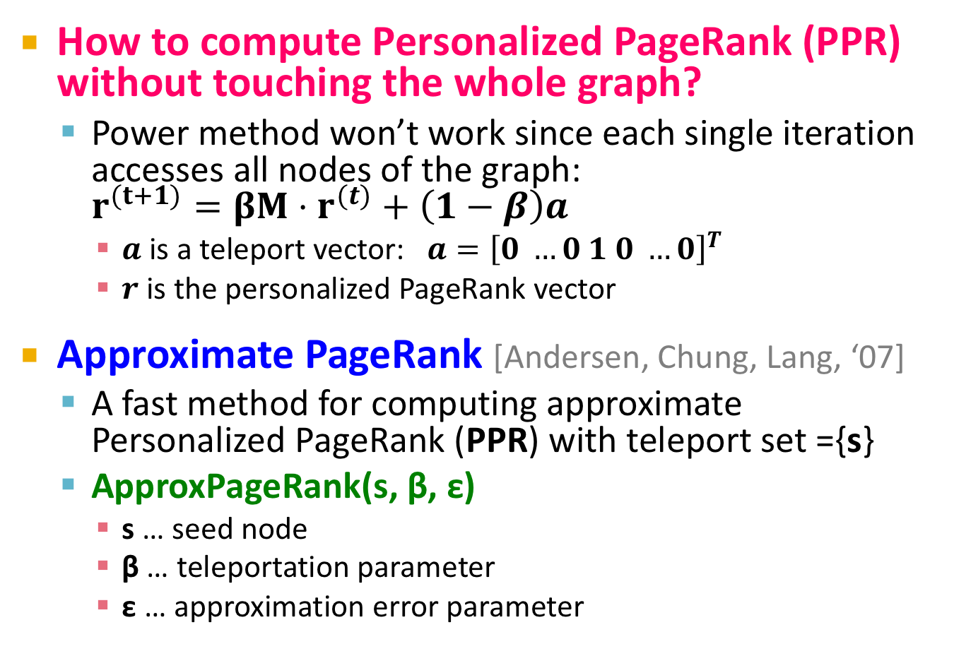
Computing PPR
How to compute Personalized PageRank (PPR) without touching the whole graph?
Power method won’t work since each single iteration accesses all nodes of the graph: $r^{(t+1)}=βM⋅r^{(t)}+\left(1−β\right)a$
$a$ is a teleport vector: $a={\left[0 …0 1 0 …0\right]}^{T}$
$r$ is the personalized PageRank vector
Approximate PageRank [Andersen, Chung, Lang, ‘07]
A fast method for computing approximate Personalized PageRank (PPR) with teleport set ={s}
ApproxPageRank(s, β, ε)
s … seed node
β … teleportation parameter
ε … approximation error parameter
At index S

Slide 20
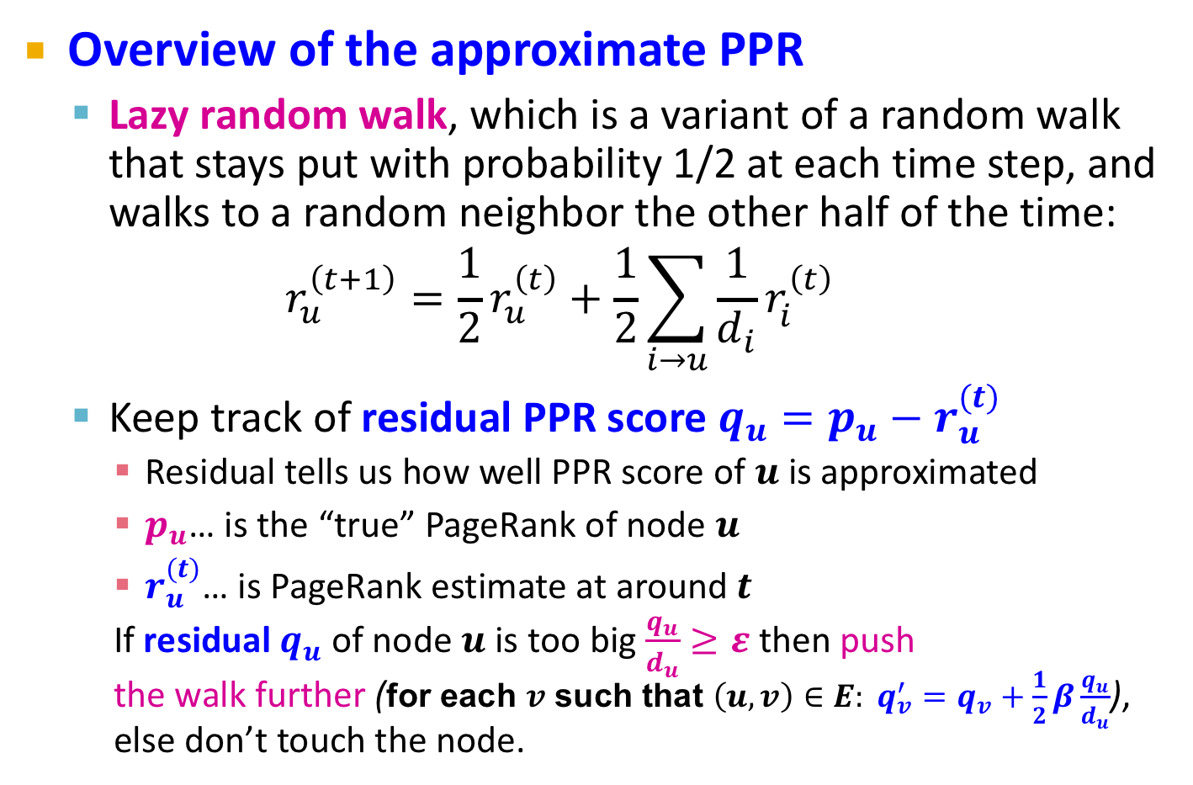
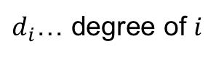
Approximate PPR: Overview
Overview of the approximate PPR
Lazy random walk, which is a variant of a random walk that stays put with probability 1/2 at each time step, and walks to a random neighbor the other half of the time:
$$r_{u}^{\left(t+1\right)}=\frac{1}{2}r_{u}^{\left(t\right)}+\frac{1}{2}\sum_{i→u}{\frac{1}{d_{i}}r_{i}^{\left(t\right)}}$$
Keep track of residual PPR score $q_{u}=p_{u}−r_{u}^{(t)}$
Residual tells us how well PPR score of $u$ is approximated
$p_{u}$… is the “true” PageRank of node $u$
$r_{u}^{(t)}$… is PageRank estimate at around $t$
If residual $q_{u}$ of node $u$ is too big $\frac{q_{u}}{d_{u}}≥ε$ then push the walk further (for each $v$ such that $\left(u,v\right)∈E: q_{v}^{′}=q_{v}+\frac{1}{2}β\frac{q_{u}}{d_{u}}$), else don’t touch the node.
$d_{i}$… degree of $i$
Notes:
If p the solution to PageRank using teleport probability α, and the lazy walk matrix, then p is also the solution to the standard PageRank equation with teleport probability α′=2α/(1+α).
We use lazy to guarantee that the Markov Chain is aperiodic

Slide 21
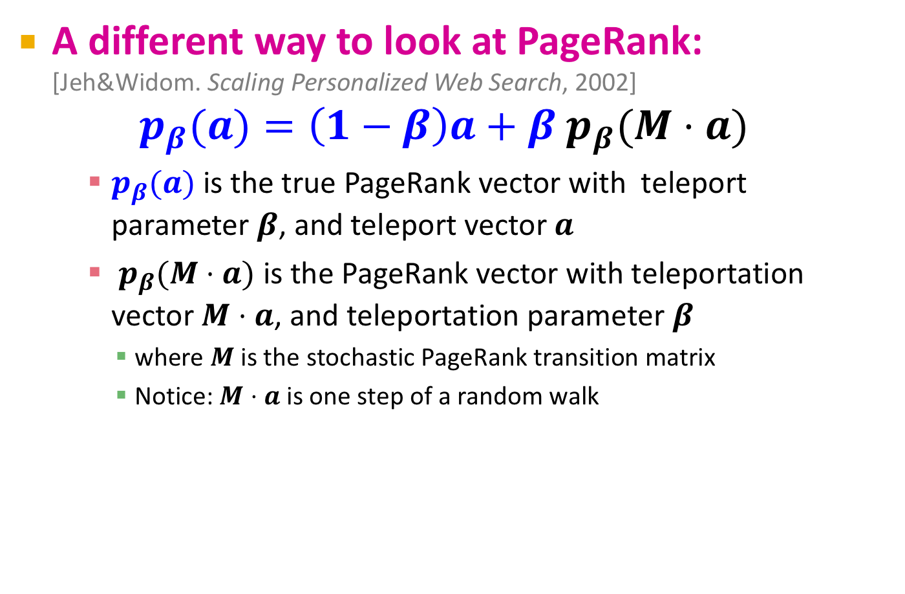
Towards approximate PPR
A different way to look at PageRank: [Jeh&Widom. Scaling Personalized Web Search, 2002]
$$p_{β}(a)=\left(1−β\right)a+β{ p}_{β}(M⋅a)$$
$p_{β}(a)$ is the true PageRank vector with teleport parameter $β$, and teleport vector $a$
${ p}_{β}(M⋅a)$ is the PageRank vector with teleportation vector $M⋅a$, and teleportation parameter $β$
where $M$ is the stochastic PageRank transition matrix
Notice: $M⋅a$ is one step of a random walk
Notes:
The notation pβ(a) here means the personalized PageRank vector personalized to a (i.e. teleporting to a).
The expression pβ(Ma) means personalized PageRank vector personalized to Ma.
Here Ma is matrix multiplication, or equivalently the distribution obtained by teleporting to distribution a then taking a single random step.
To understand why this is true, we will use the fact that pβ(a)i is the probability of ending at node i after a single random walk from distribution $a$ with length geometric(β).
Now to prove that
pβ(a)=(1−β)a+βpβ(Ma)
we can break this probability into two cases: walks of length 1 (0 transitions), and walks of length longer than 1 (>0 transitions). The probability of length 0 is β, and the walk ends where it started, with distribution a. The probability of length 1 is 1−β, and then the walk starts at distribution a, takes a step, (so it has distribution Ma), then takes the rest of the random walk to with distribution pβ(Ma). Note that we used the memorless nature of the walk: After we know the second node of the walk has distribution Ma, the rest of the walk can forget where it started and behave as if it started at Ma. This proves the equation.
Original answer: (Which explains a different PageRank equation in terms of random walks).
This might be clearer if we remove the teleport probability β subscript from the notation. Then the equation is
p=(1−β)a+βpM.
Here p is the personalized PageRank, a is the teleport vector, M is the stochastic transition matrix, and pM is matrix multiplication. To understand why this equation makes sense, think about the random walk model: we take an infintely long walk, and after each step with probability β we teleport to a random node in a, and otherwise we step to a random neighbor of the current node.
The left-hand-side at entry i is the probability of being at some node i at equilibrium (after infinitely many steps, the stationary distribution). At equilibrium, what is our probability of being at some node i? Well, either on the previous step we teleported, which happens with probability 1−β, and our probability of being at node i is ai. That's the first term on the right-hand-side. Or, on the previous step we were at some node j, (with probability pj since our previous step was also at stationary distribution) and our probability of going to i is
∑ipjMj,i=pM
which gives us the second term on the right-hand-side.

Slide 22
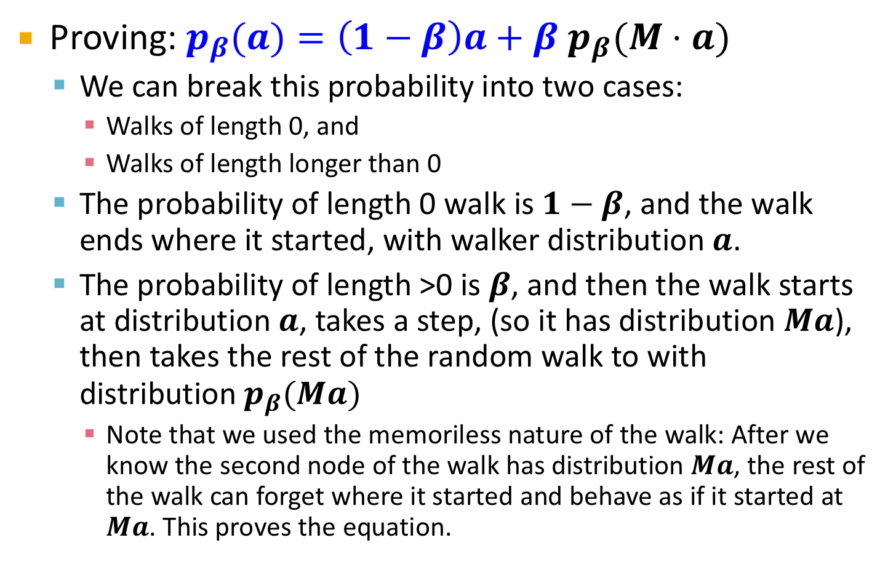
Towards approximate PPR
Proving: $p_{β}(a)=\left(1−β\right)a+β{ p}_{β}(M⋅a)$
We can break this probability into two cases:
Walks of length 0, and
Walks of length longer than 0
The probability of length 0 walk is $1−β$, and the walk ends where it started, with walker distribution $a$.
The probability of length >0 is $β$, and then the walk starts at distribution $a$, takes a step, (so it has distribution $Ma$), then takes the rest of the random walk to with distribution $p_{β}(Ma)$
Note that we used the memoriless nature of the walk: After we know the second node of the walk has distribution $Ma$, the rest of the walk can forget where it started and behave as if it started at $Ma$. This proves the equation.

Slide 23
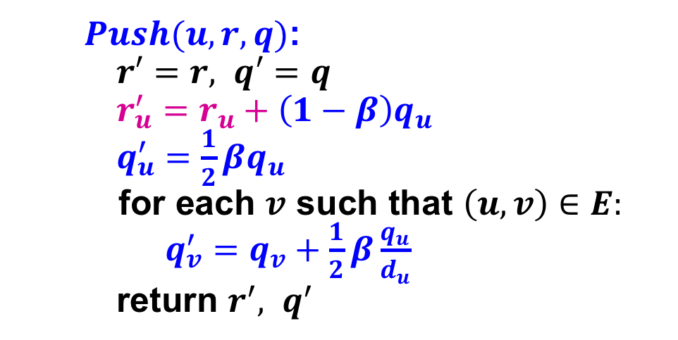
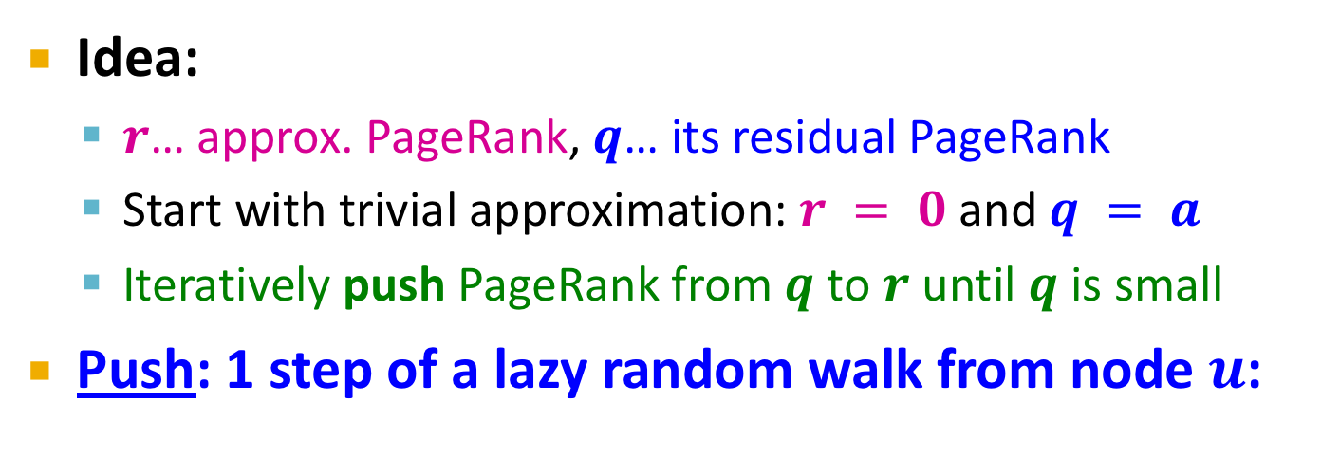
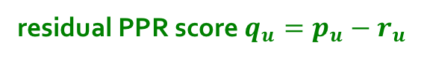
“Push” Operation
residual PPR score $q_{u}=p_{u}−r_{u}^{}$
Idea:
$r$… approx. PageRank, $q$… its residual PageRank
Start with trivial approximation: $r = 0$ and $q = a$
Iteratively push PageRank from $q$ to $r$ until $q$ is small
Push: 1 step of a lazy random walk from node $u$:
$Push(u, r, q)$:
$r′=r, q′=q$
$r_{u}^{′}=r_{u}+\left(1−β\right)q_{u}$
$q_{u}^{′}=\frac{1}{2}βq_{u}$
for each $v$ such that $\left(u,v\right)∈E:$
$q_{v}^{′}=q_{v}+\frac{1}{2}β\frac{q_{u}}{d_{u}}$
return $r^{′}, q^{′}$
Update r
Do 1 step of a walk:
Stay at u with prob. ½
Spread remaining ½ fraction of q_{u} as if a single step of random walk were applied to u

Slide 24
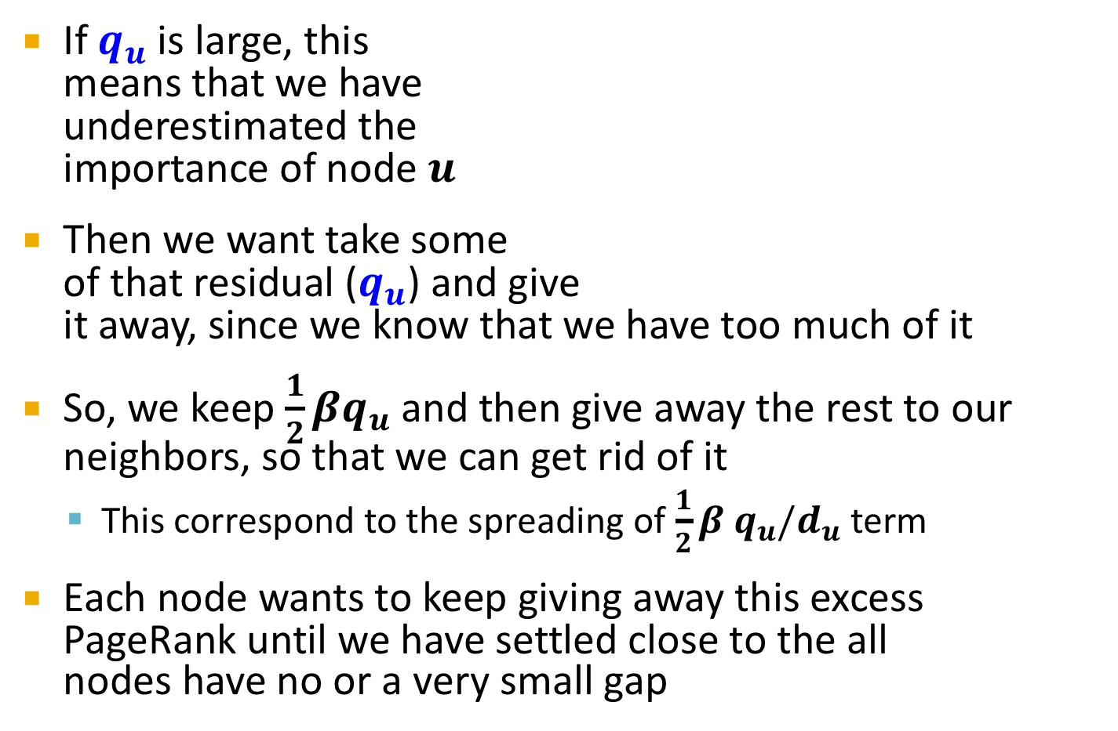
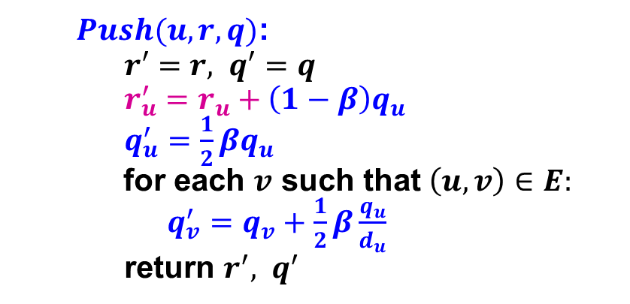
Intuition Behind Push Operation
$Push(u, r, q)$:
$r′=r, q′=q$
$r_{u}^{′}=r_{u}+\left(1−β\right)q_{u}$
$q_{u}^{′}=\frac{1}{2}βq_{u}$
for each $v$ such that $\left(u,v\right)∈E:$
$q_{v}^{′}=q_{v}+\frac{1}{2}β\frac{q_{u}}{d_{u}}$
return $r^{′}, q^{′}$
If $q_{u}$ is large, this means that we have underestimated the importance of node $u$
Then we want take some of that residual ($q_{u}$) and give it away, since we know that we have too much of it
So, we keep $\frac{1}{2}βq_{u}$ and then give away the rest to our neighbors, so that we can get rid of it
This correspond to the spreading of $\frac{1}{2}β q_{u}/d_{u}$ term
Each node wants to keep giving away this excess PageRank until we have settled close to the all nodes have no or a very small gap
Notes:
A silly metaphor I can think of is imagine that you are a person who is feels very disrespected by the world (your page rank/reputation is too low).
Well, you might try to make yourself feel better by insulting the people around you; by smearing the reputation of others and decreasing their reputation (i.e pagerank) you could make yourself seem slightly better, as other people will spend more time noticing their flaws, and less time on yours (so, your reputation/page rank has increased).
When you are upset, you lash out at people at random, thus our q_u/d_u term, but half the time, you have a good day (sun is shining, birds singing, 246 assignment finished, etc) and don't insult others, which is where our .5 term comes from.
Anyways, you could imagine the whole world worked this way, until people finally settle into something close to an equilibrium where everyone feels they are respected the amount they deserve (i.e qu close to 0). Further, if we live in a world in which people are flexible and willing to be slightly under/over valued, then this cycle of hostility would end sooner, (thus the 1/epsilon term in our run time).

Slide 25
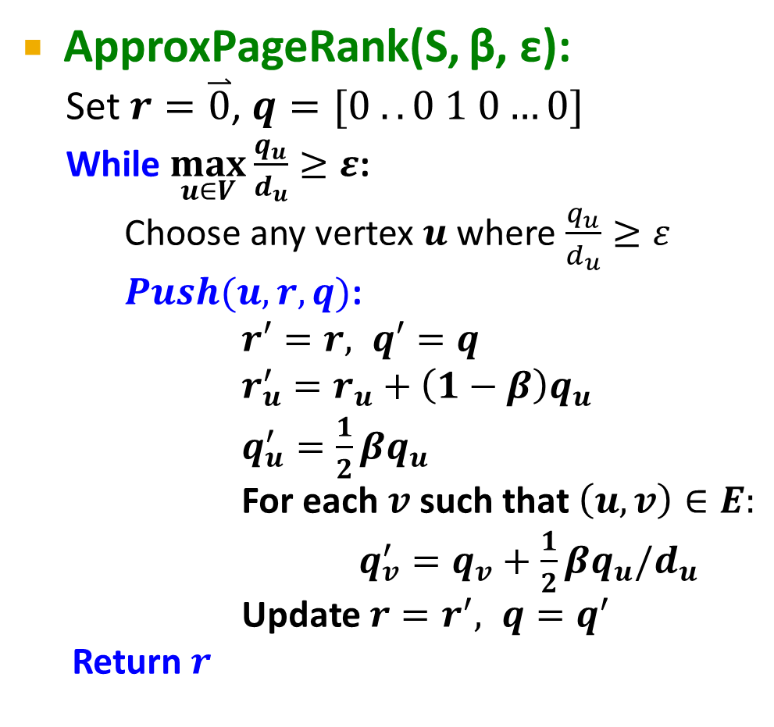
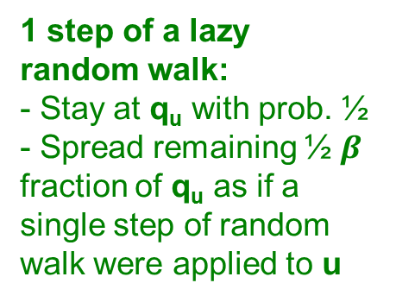
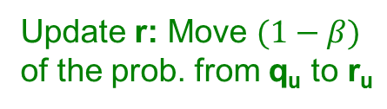
Approximate PPR
ApproxPageRank(S, β, ε):
Set $r=\overset{⃑}{0}$, $q=[0 ..0 1 0…0]$
While $\max_{u∈V}\frac{q_{u}}{d_{u}}≥ε$:
Choose any vertex $u$ where $\frac{q_{u}}{d_{u}}≥ε$
$Push(u, r, q)$:
$r′=r, q′=q$
$r_{u}^{′}=r_{u}+\left(1−β\right)q_{u}$
$q_{u}^{′}=\frac{1}{2}βq_{u}$
For each $v$ such that $\left(u,v\right)∈E:$
$q_{v}^{′}=q_{v}+\frac{1}{2}βq_{u}/d_{u}$
Update $r=r^{′}, q=q^{′}$
Return $r$
r … PPR vector
r_{u} …PPR score of u
q …residual PPR vector
q_{u} … residual of node u
d_{u} … degree of u
At index S
Update r: Move $(1−β)$ of the prob. from q_{u} to r_{u}
1 step of a lazy random walk:
- Stay at q_{u} with prob. ½
- Spread remaining ½ $β$ fraction of q_{u} as if a single step of random walk were applied to u
Notes:
Lazy random walks, which are the variant of random walks that stay put with probability 1/2 at each time step, and walk to a random neighbor the other half of the time.
Better explain the algorithm.
What is going on?
What are q and r
How is the mass being shifted round

Slide 26


Example: $β=0.5$
s a b c
Init:
r = [0, 0, 0, 0]
q = [1, 0, 0, 0]
Push(s, r, q):
r = [.5, 0, 0, 0]
q = [.25, .08, .08, .08]
Push(s, r, q):
r = [.62, 0, 0, 0]
q = [.06, .10, .10, .10]
Push(a, r, q):
r = [0.62, .05, 0, 0]
q = [.09, .03, .10, .10]
Push(b, r, q):
r = [0.62, .05, .05, 0]
q = [.09, .05, .03, .10]
….
r = [.57, .19, .14, .09]
s
c
b
ApproxPageRank(S, β, ε):
Set $r=\overset{⃑}{0}$, $q=\left[0 ..0 1 0…0\right]$
while $\max_{u∈V}\frac{q_{u}}{d_{u}}≥ε$:
Choose any vertex $u$ where $\frac{q_{u}}{d_{u}}≥ε$
$Push(u, r, q)$:
$r′=r, q′=q$
$r_{u}^{′}=r_{u}+\left(1−β\right)q_{u}$
$q_{u}^{′}=\frac{1}{2}βq_{u}$
For each $v$ such that $\left(u,v\right)∈E:$
$q_{v}^{′}=q_{v}+\frac{1}{2}β\frac{q_{u}}{d_{u}}$
Update $r=r^{′}, q=q^{′}$
return $r$
a

Slide 27
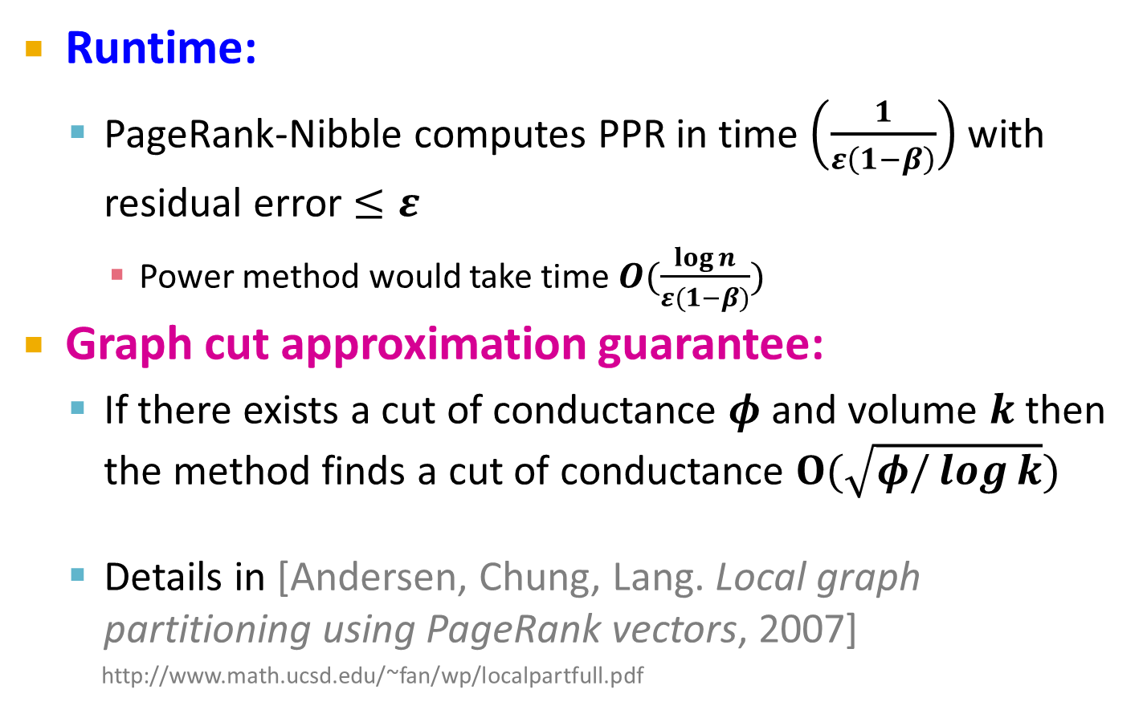
Observations (1)
Runtime:
PageRank-Nibble computes PPR in time $\left(\frac{1}{ε\left(1−β\right)}\right)$ with residual error $≤ε$
Power method would take time $O(\frac{\log{n}}{ε(1−β)})$
Graph cut approximation guarantee:
If there exists a cut of conductance $φ$ and volume $k$ then the method finds a cut of conductance $O(\sqrt{φ/\log{k}})$
Details in [Andersen, Chung, Lang. Local graph partitioning using PageRank vectors, 2007]
http://www.math.ucsd.edu/~fan/wp/localpartfull.pdf

Slide 28
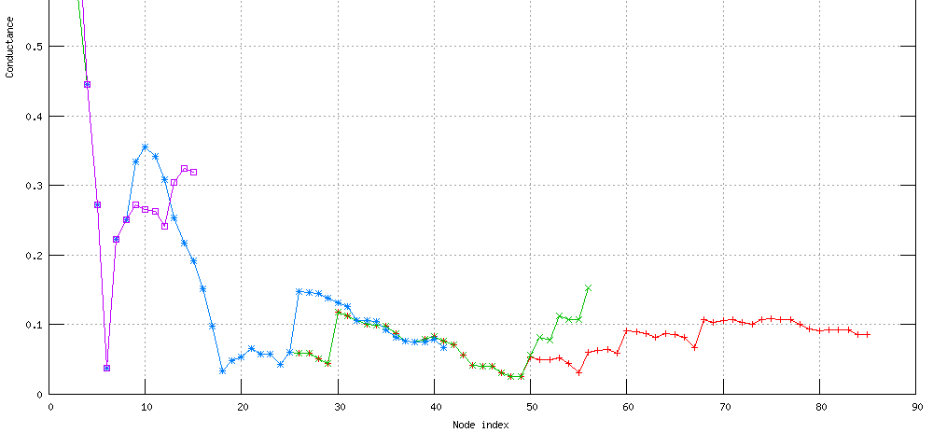
Observations (2)
The smaller the ε the farther the random walk will spread!
Seed node

Slide 29
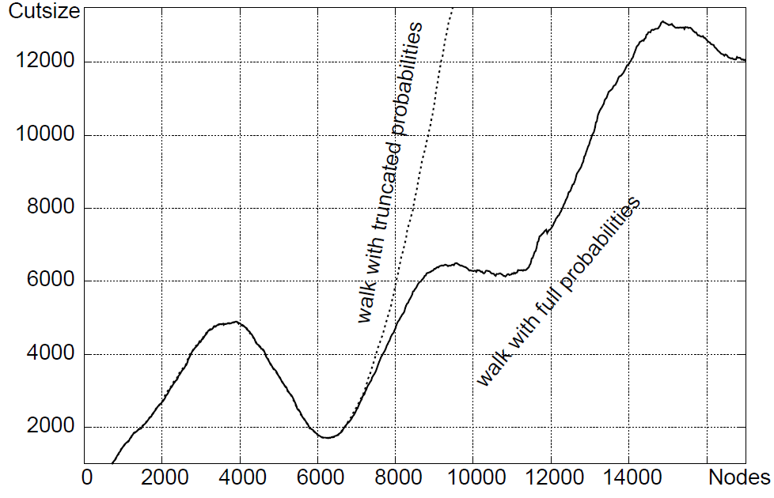
Observations (3)
[Andersen, Lang: Communities from seed sets, 2006]

Slide 30
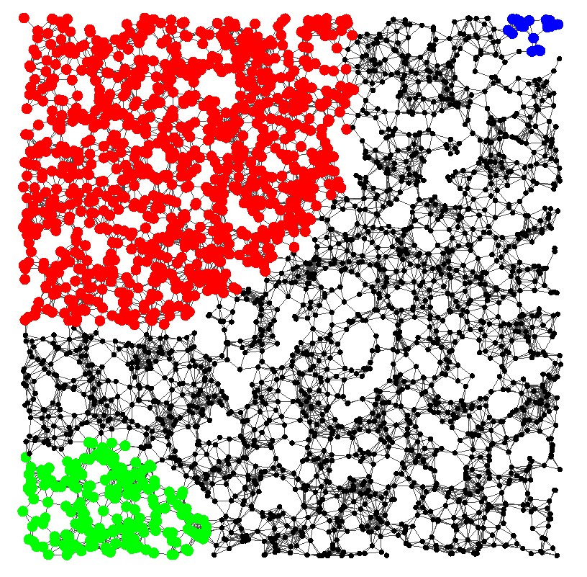
Example

Slide 31
Summary
Good clusters
Cluster “quality” (lower is better)
Seed node
Algorithm summary:
Pick a seed node s of interest
Run PPR with teleport set = {s}
Sort the nodes by the decreasing PPR score
Sweep over the nodes and find good clusters
Node rank in decreasing PPR score

Slide 32
Motif-Based Local Spectral Clustering

Slide 33
Motif-based Spectral Clustering
What if we want our clustering based on other patterns (not edges)?
Small subgraphs (motifs, graphlets) are building blocks of networks [Milo et al., ’02]

Slide 34
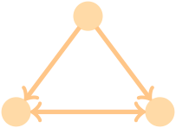
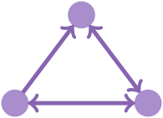
Motif-based spectral clustering
Network:
Motif:

Slide 35
Re-define Conductance for Motifs
Generalize cuts and volumes to motifs
$$edges cut$$
$$motifs cut$$
$vol(S)$ = #(edge end-points in S)
$volM(S)$ = #(motif end-points in S)
$$φ\left(S\right)=\frac{\#(edges cut)}{vol(S)}$$
$$φM\left(S\right)=\frac{\#(motifs cut)}{vol_{M}(S)}$$
Optimize motif conductance [Benson et al., ’16]

Slide 36
Motif-based Clustering
Three basic stages:
1) Pre-processing
W_{ij}^{(M)} = # times (i, j) participates in the motif
2) PageRank Nibble
Same as before but on weighted W^{(M)}
3) Sweep
Same as before
1
1
1
1
1
3
1
1
1
1
2
1
1
1
1
Graph G
Weighted graph W^{(M)}

Slide 37
Motif-based Clustering of a Food Web
Pelagic fishes
and benthic prey
Micro-
nutrient
sources
Benthic Fishes
Use multiple eigenvectors or recursive bi-partitioning to get multiple clusters
Benthic Macroinvertibrates

Slide 38
Motif Clustering of a Neural Network
Neuron locations
“Bi-fan” motif known to be important in neural networks [Milo et al., ’02]
Ring motor (RME*) neurons act as inputs
Inner labial sensory (IL2*) neurons are the destinations
URA neurons act as intermediaries

Slide 39
Analysis of Large Graphs: Trawling

Slide 40
Method: Trawling
[Kumar et al. ‘99]
Search for small communities in a Web graph
What is the signature of a community/discussion in a Web graph?
Use this to define “topics”:
What the same people on the left talk about on the right
Remember HITS!
…
…
…
Dense 2-layer graph
Intuition: Many people all talking about the same things

Slide 41
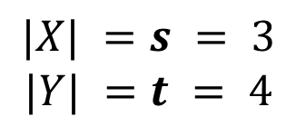
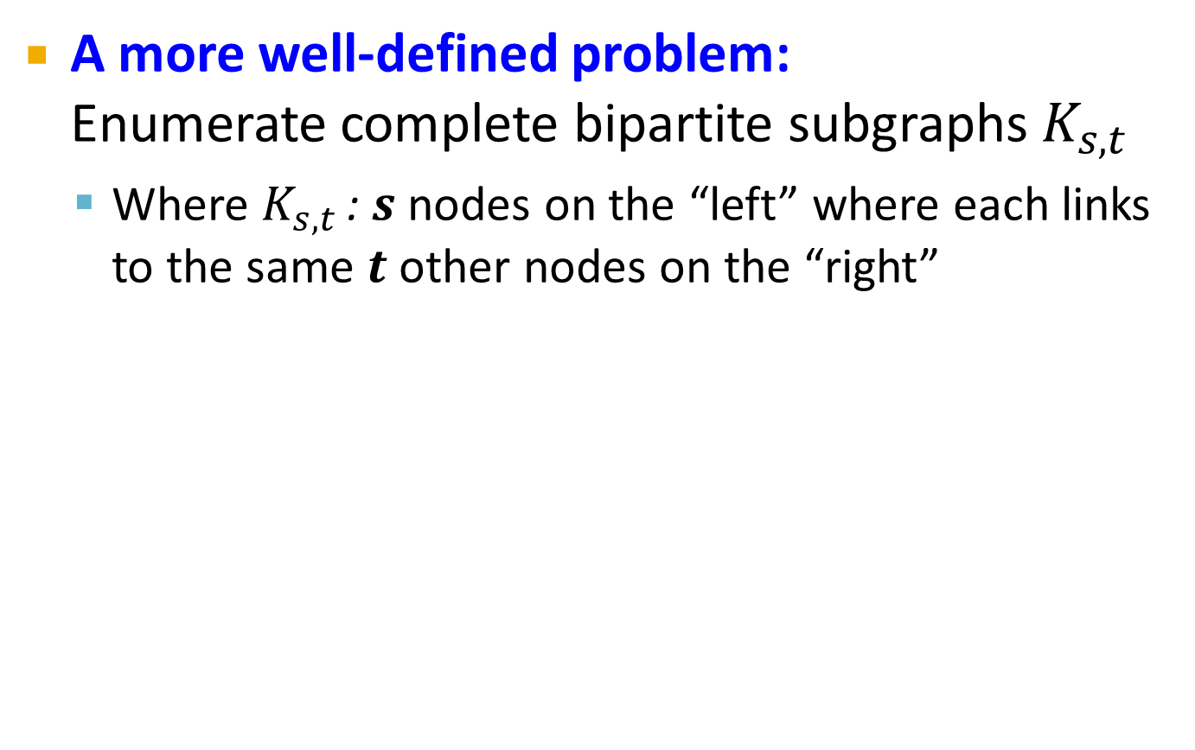
Searching for Small Communities
A more well-defined problem: Enumerate complete bipartite subgraphs $K_{s,t}$
Where $K_{s,t}$ : $s$ nodes on the “left” where each links to the same $t$ other nodes on the “right”
$$|X| =s = 3$$
$$|Y| =t = 4$$
X
Y
K_{3,4}
Fully connected

Slide 42
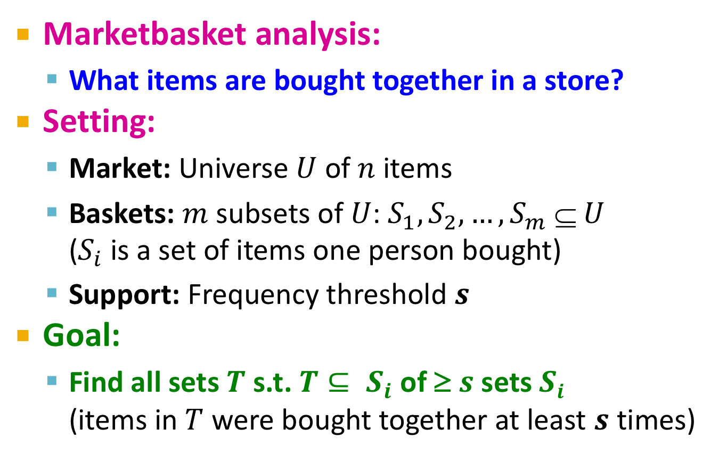
Remember: Frequent Itemsets
[Agrawal-Srikant ‘99]
Marketbasket analysis:
What items are bought together in a store?
Setting:
Market: Universe $U$ of $n$ items
Baskets: $m$ subsets of $U$: $S_{1}, S_{2}, …, S_{m}  U$ ($S_{i}$ is a set of items one person bought)
Support: Frequency threshold $s$
Goal:
Find all sets $T$ s.t. $T⊆ S_{i}$ of ≥ $s$ sets $Si$ (items in $T$ were bought together at least $s$ times)
Products sold in a store

Slide 43
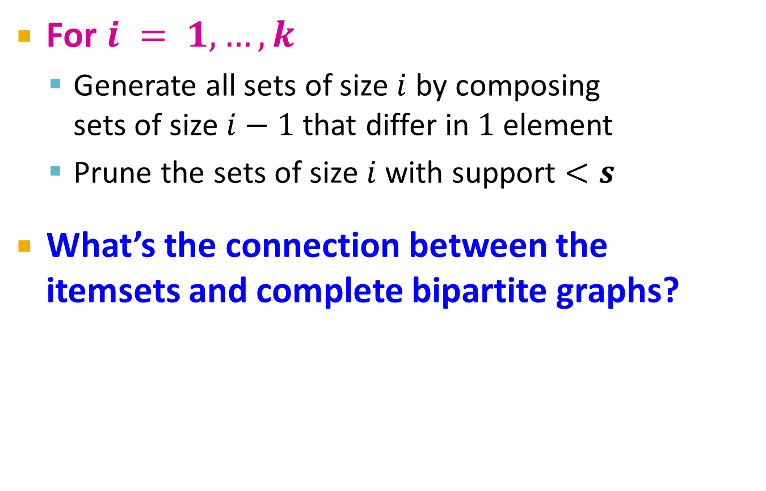
The Apriori Algorithm
[Agrawal-Srikant ‘99]
For $i = 1,…, k$
Generate all sets of size $i$ by composing sets of size $i−1$ that differ in $1$ element
Prune the sets of size $i$ with support $<s$
What’s the connection between the itemsets and complete bipartite graphs?

Slide 44

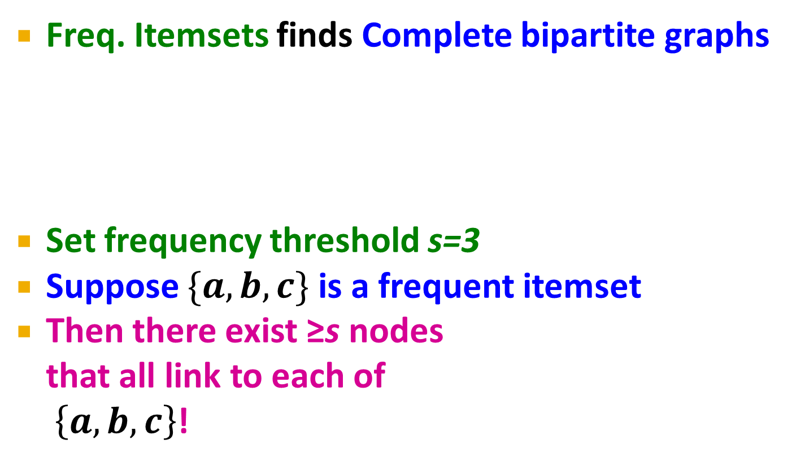

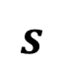
From Itemsets to Bipartite K_{s,t}
Freq. Itemsets finds Complete bipartite graphs
Set frequency threshold s=3
Suppose $\{a,b,c\}$ is a frequent itemset
Then there exist ≥s nodes that all link to each of $\left\{a,b,c\right\}$!
a
Every node i is an itemset
$$Si=\{a,b,c,d\}$$
b
i
c
d
$$s$$
$$t$$
a
j
b
i
c
k
d

Slide 45
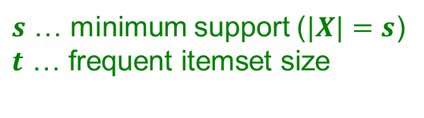
From Itemsets to Bipartite K_{s,t}
[Kumar et al. ‘99]
Freq. Itemsets finds Complete bipartite graphs
How?
View each node $i$ as a set $Si$ of nodes $i$ points to
$K_{s,t}$ = a set $Y$ of size $t$ that occurs in $s$ sets $S_{i}$
Finding $K_{s,t}$ is equivalent to finding itemsets of frequency threshold $s$ and then look at layer $t$
a
b
i
c
d
$$Si=\{a,b,c,d\}$$
a
j
b
i
c
k
d
X
Y
$s$ … minimum support ($|X|=s$) $$t\text{ … }\text{frequent} \text{itemset} \text{size}$$

Slide 46
From Itemsets to Bipartite K_{s,t}
[Kumar et al. ‘99]
View each node i as a set S_{i} of nodes i points to
Say we find a frequent itemset Y={a,b,c} of supp s So, there are s nodes that link to all of {a,b,c}:
a
b
i
c
a
a
d
b
a
S_{i}={a,b,c,d}
b
x
y
z
c
c
b
Find frequent itemsets:
s … minimum support
t … itemset size
c
We found K_{s,t}!
K_{s,t} = a set Y of size t that occurs in s sets S_{i}
a
x
b
y
c
z
Y
X

Slide 47
Example (1)
a
b
Support threshold s=2
{b,d}: support 3
{e,f}: support 2
And we just found 2 bipartite subgraphs:
c
d
e
f
Itemsets:
a = {b,c,d}
b = {d}
c = {b,d,e,f}
d = {e,f}
e = {b,d}
f = {}
a
b
c
d
c
d
e
f
e

Slide 48
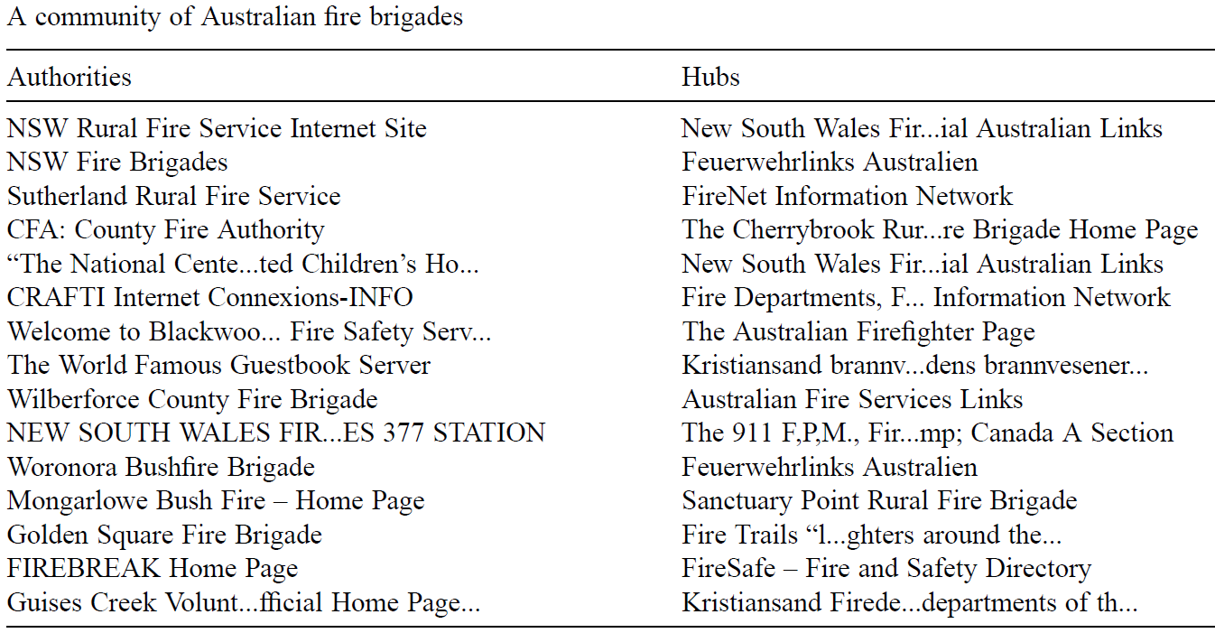
Example (2)
Example of a community from a web graph
Nodes on the right
Nodes on the left
[Kumar, Raghavan, Rajagopalan, Tomkins: Trawling the Web for emerging cyber-communities 1999]

Slide 49
Trawling — Summary
[Kumar et al. ‘99]
Algorithmic result:
Frequent itemset extraction and dynamic programming find graphs K_{s,t}
Method is very scalable
Further improvements: Given s and t
(Repeatedly) prune out all nodes with out-degree < t and in-degree < s
a
j
b
i
c
k
d

